Slide 1

Unsupervised Learning using K-means Clustering: Python Vs ArcGIS
Cristian Noriega Monsalve, Blessing Austin-Gabriel, Ernest Chianumba, Rolih Ferdinand

Slide 2
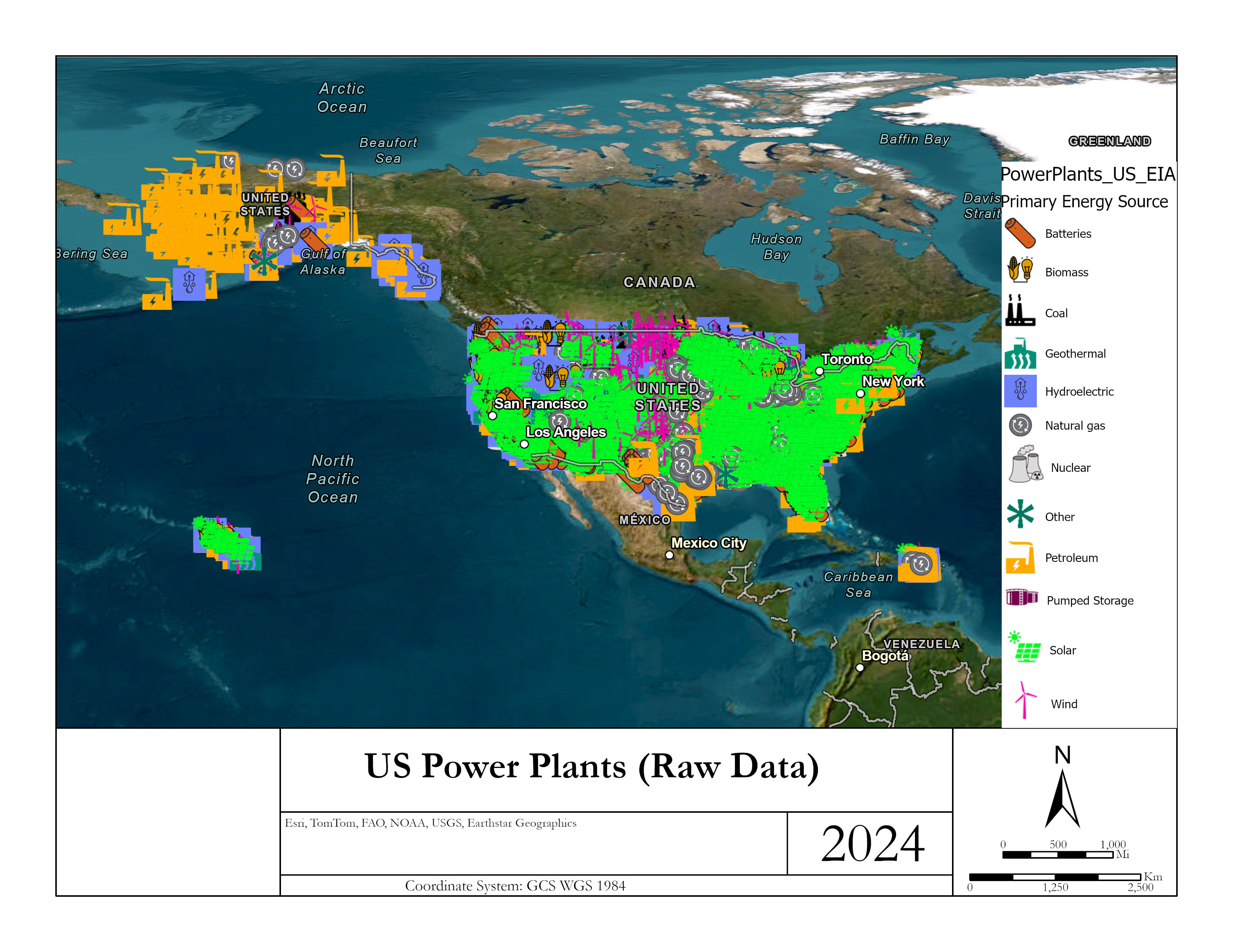
Data Set Visualization

Slide 3
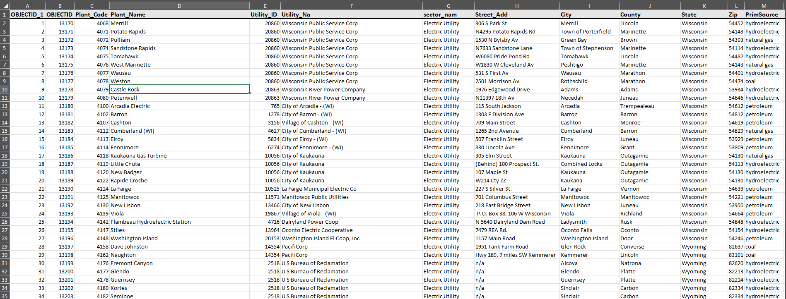
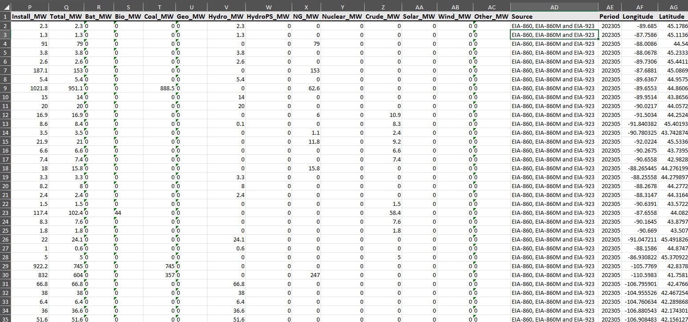
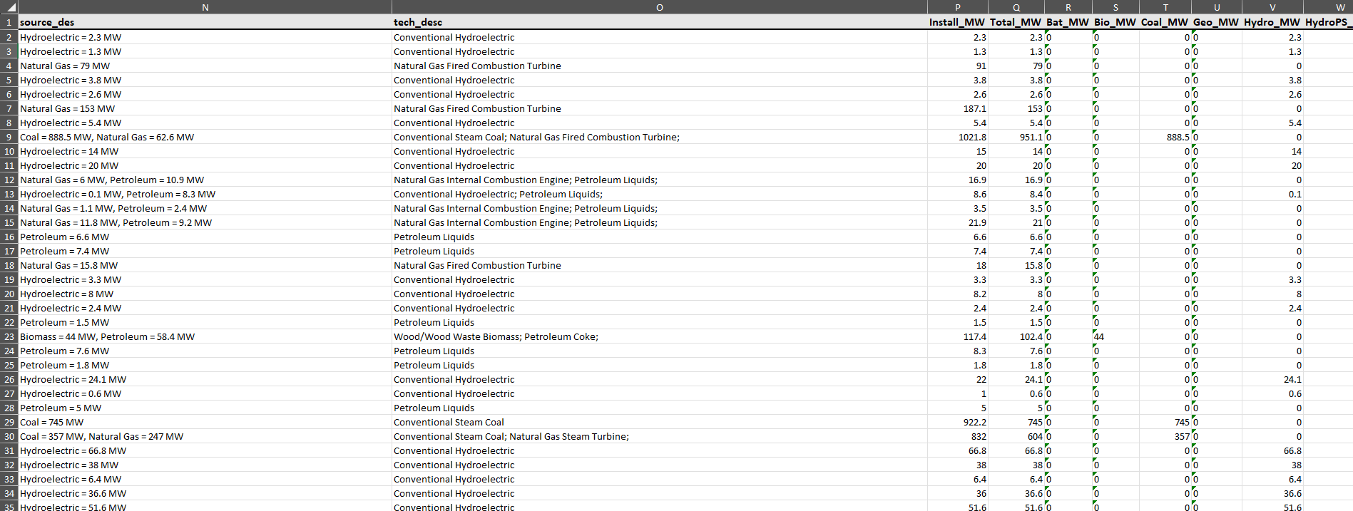
Data Set Description

Slide 4
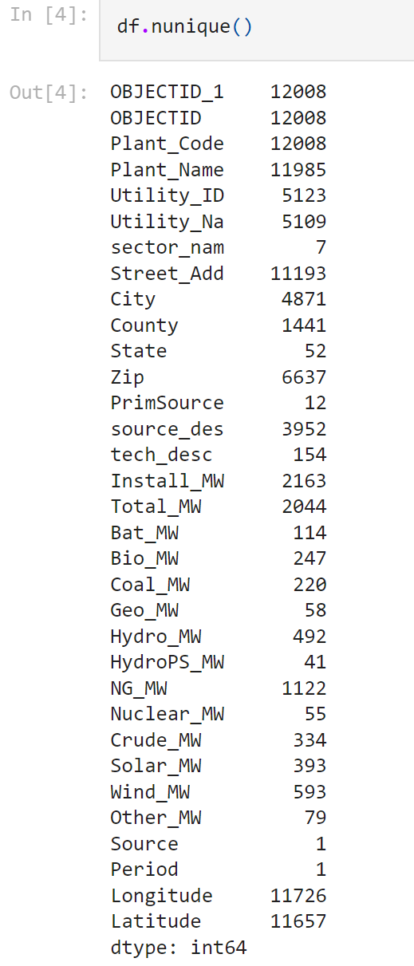
Data Statistics

Slide 5
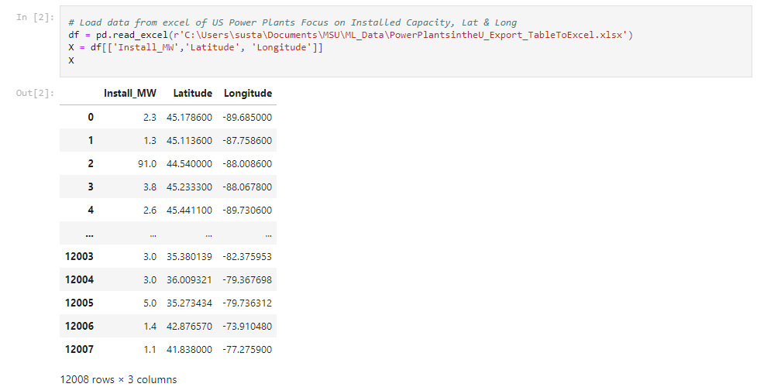
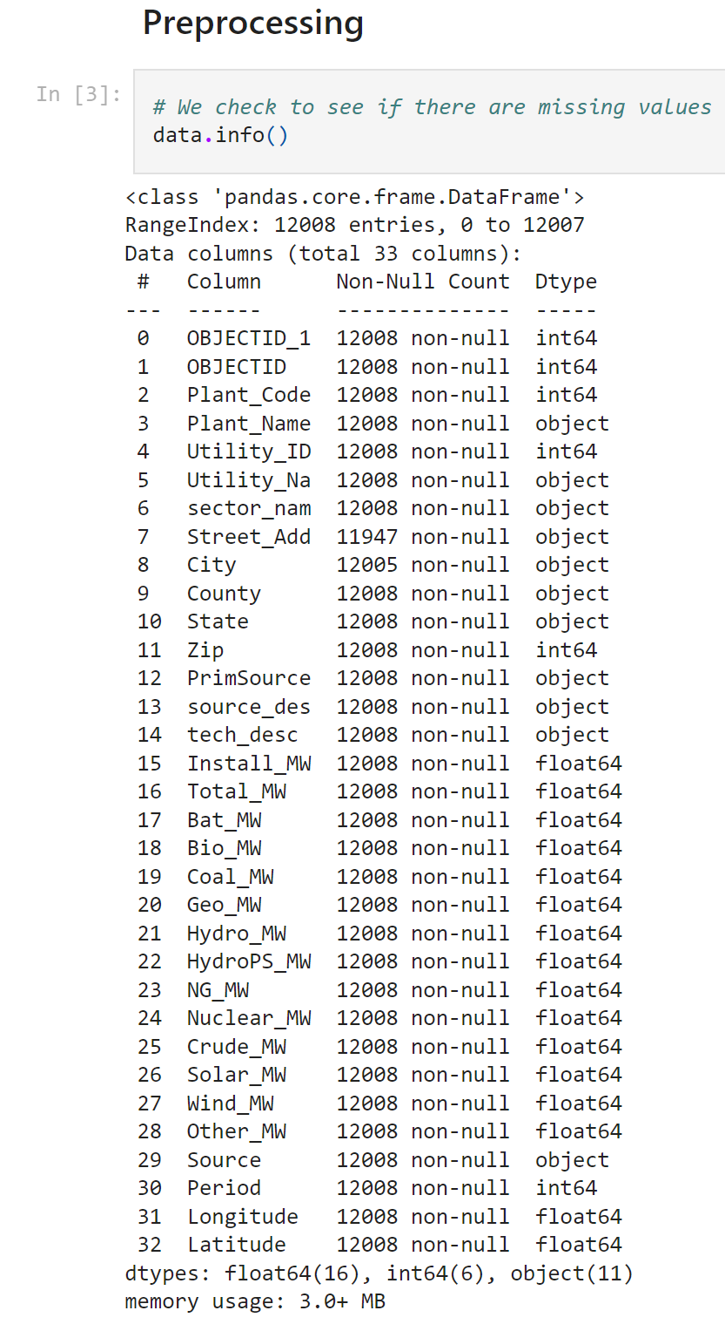
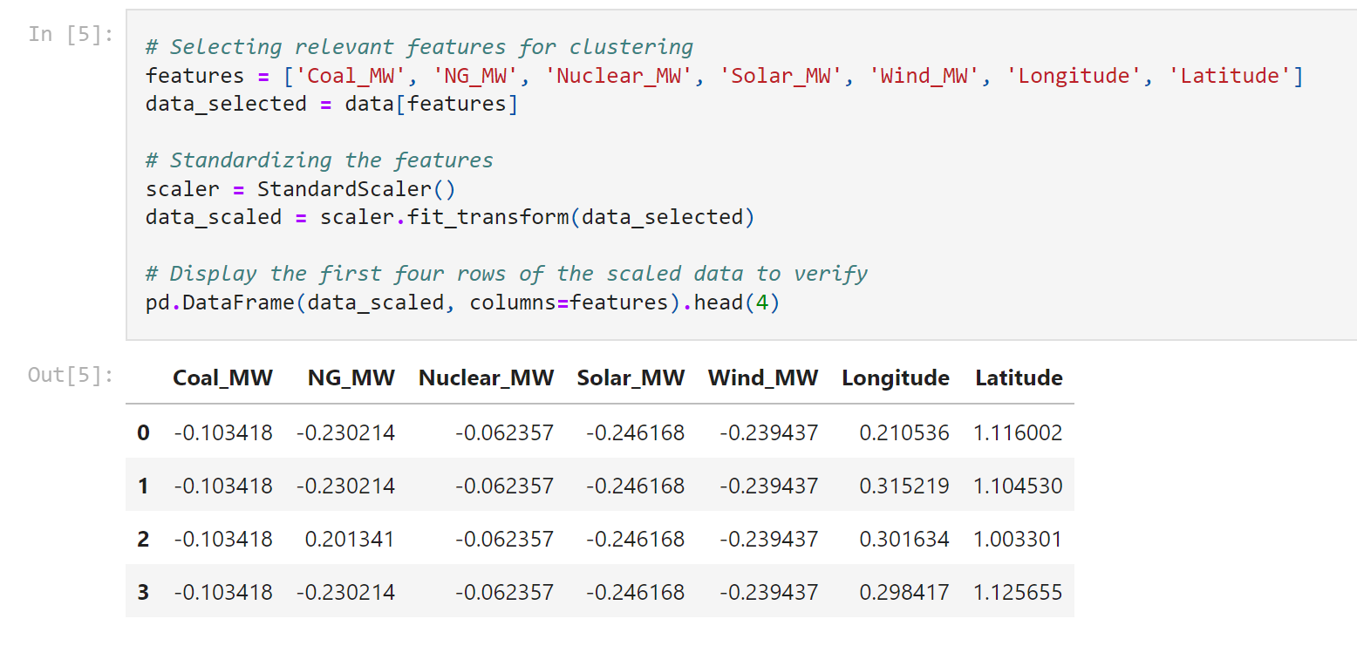
Preprocessing Techniques

Slide 6
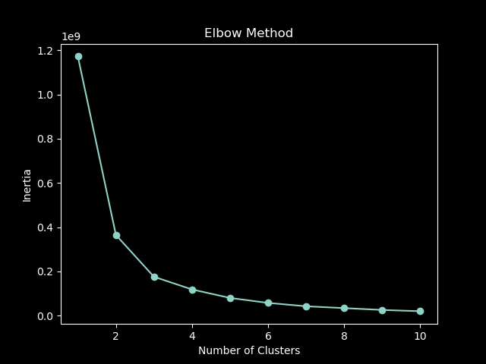
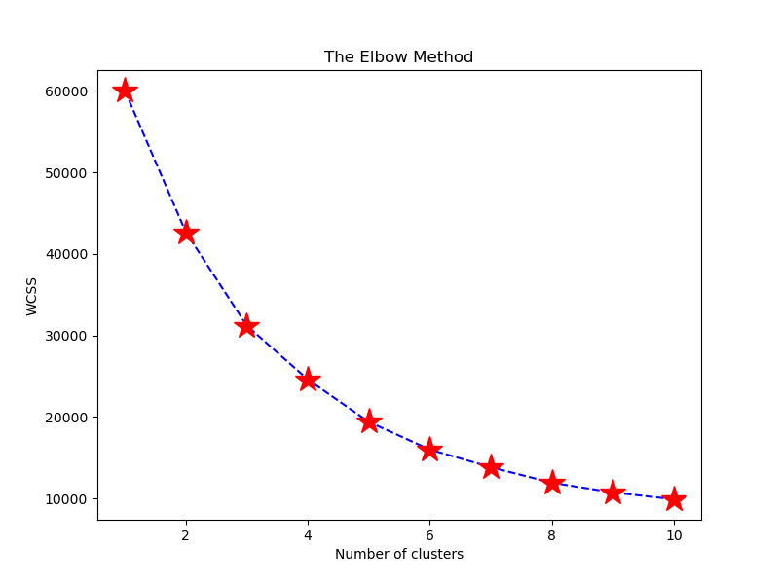
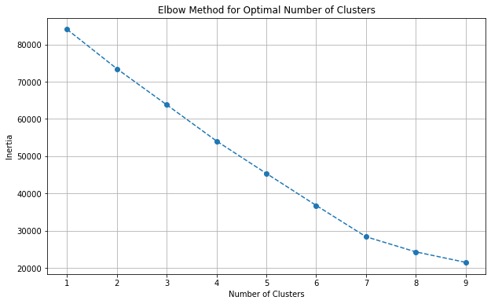
Machine Learning Technique: K-means Clustering

Slide 7
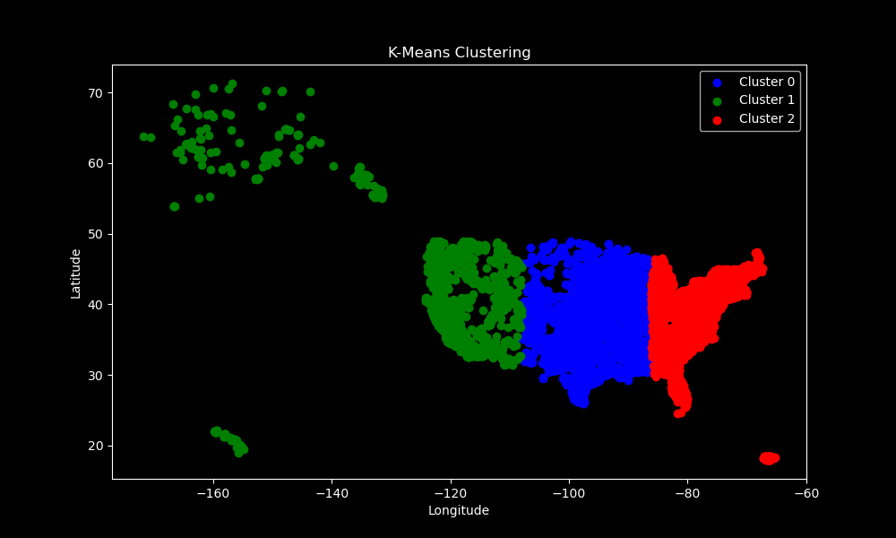
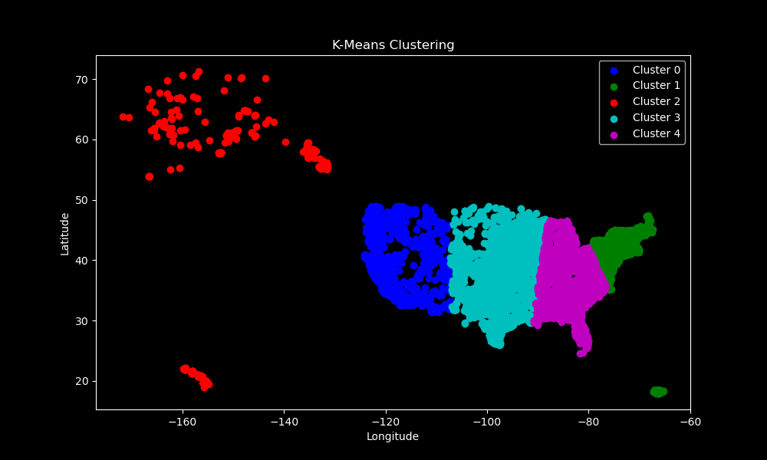
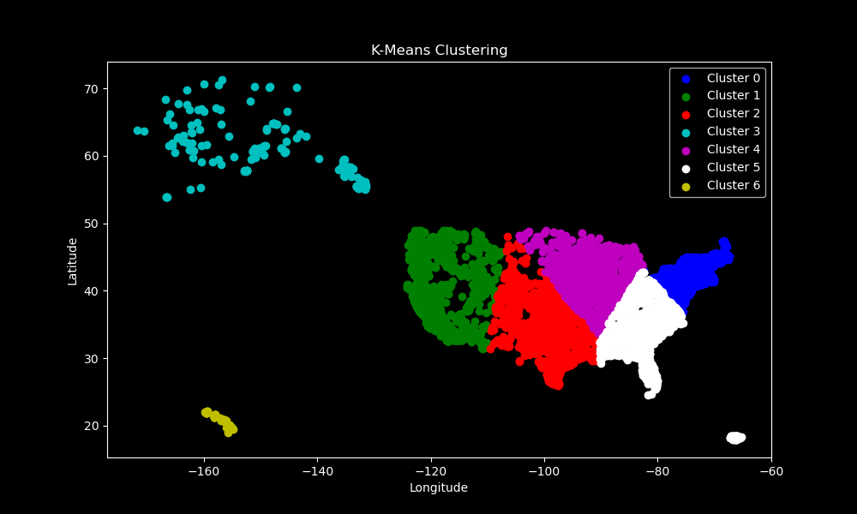
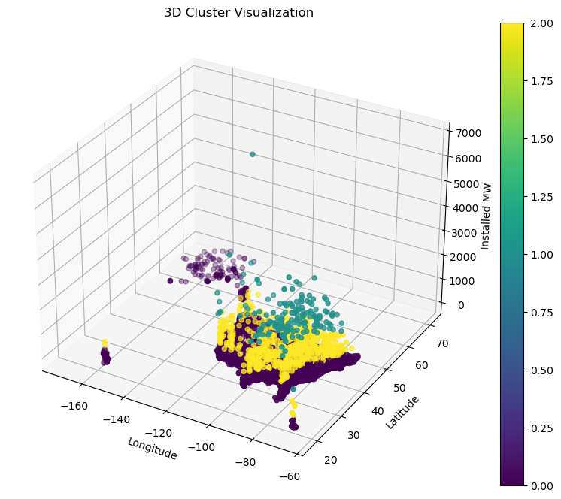
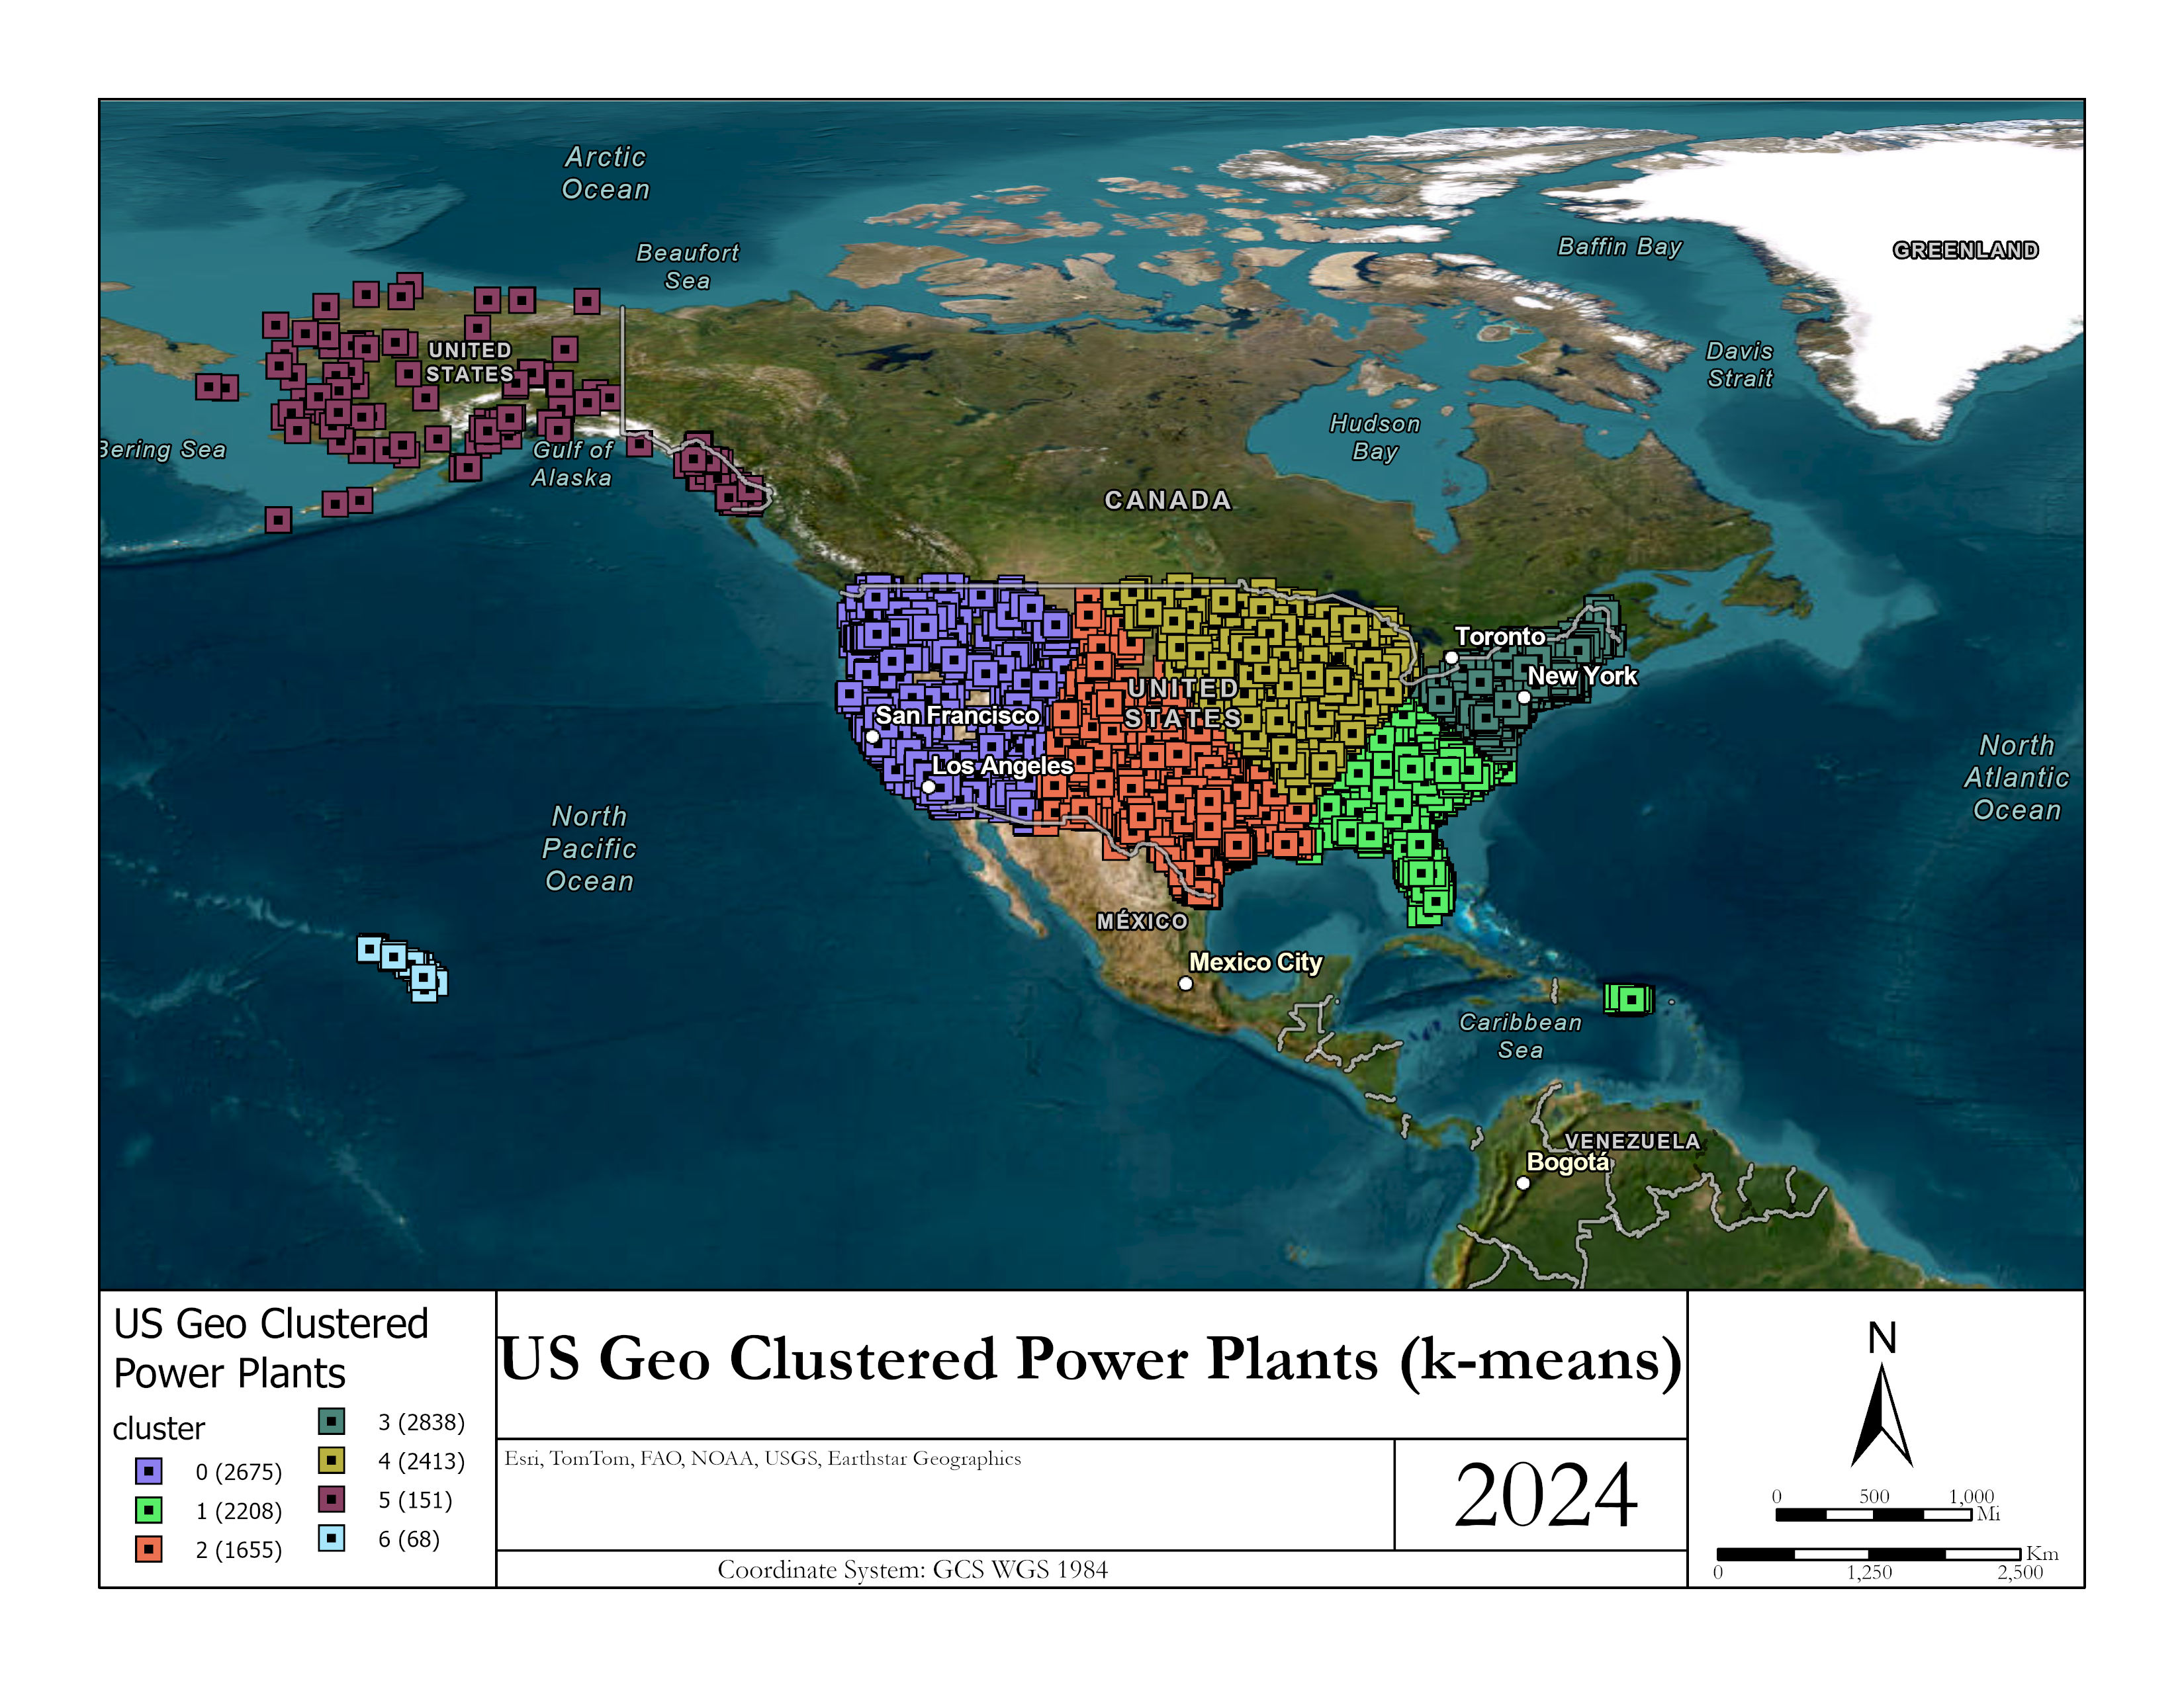
Python Results

Slide 8
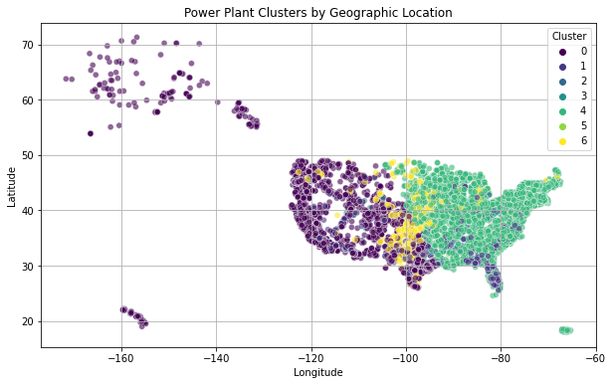
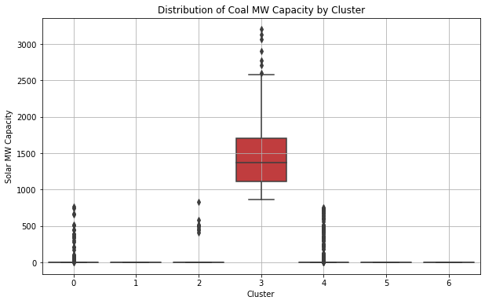
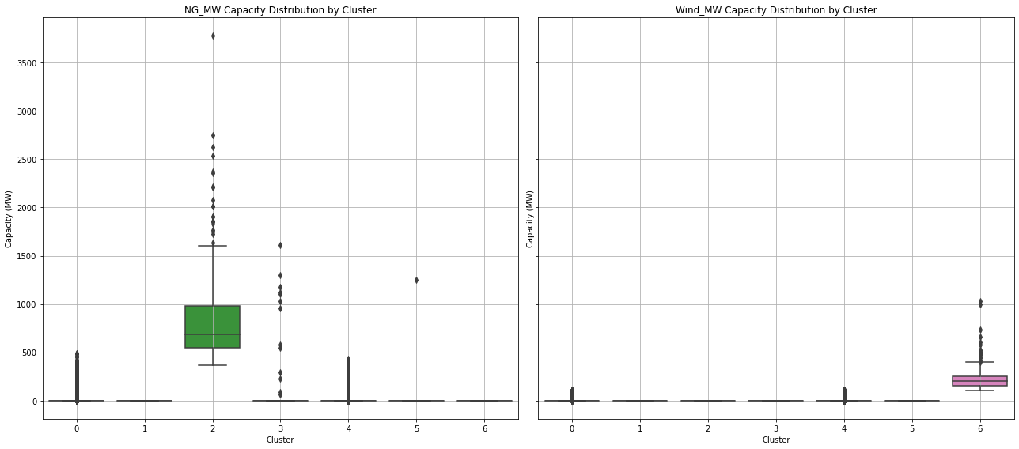
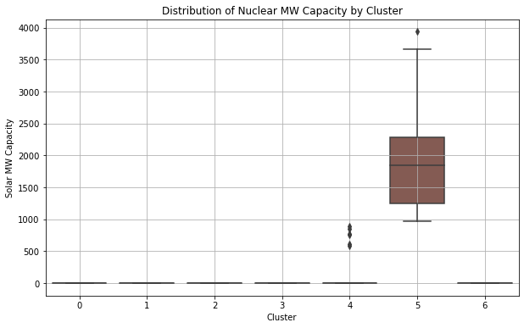
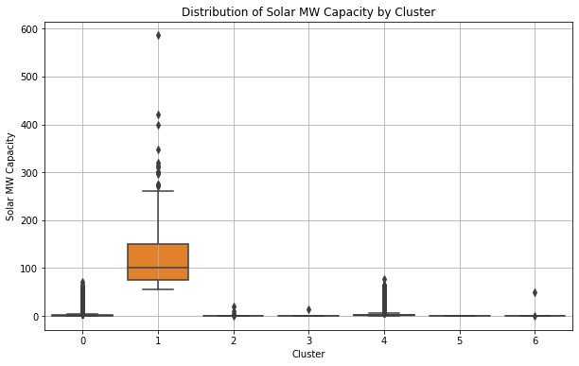
Python Results Pt 2

Slide 9
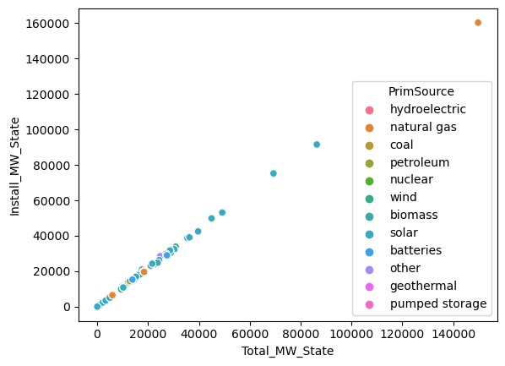
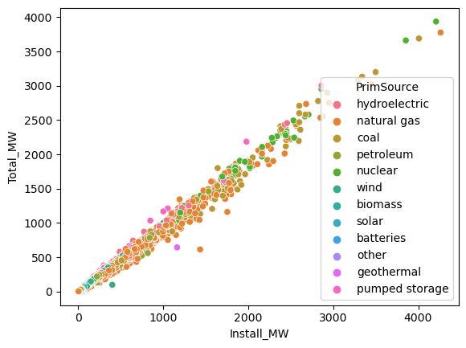
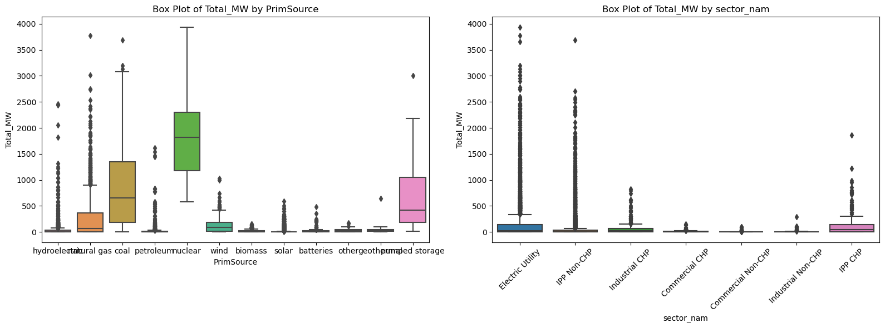
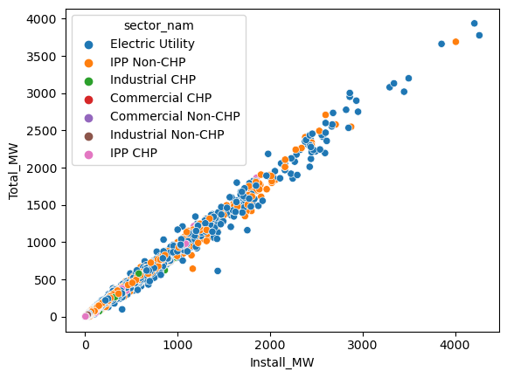
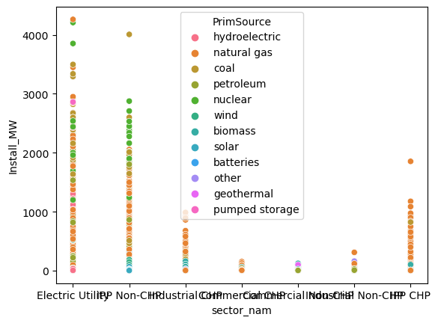
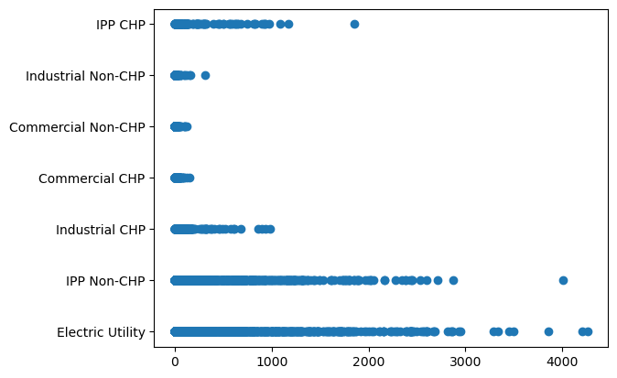
Python Results Pt 3

Slide 10
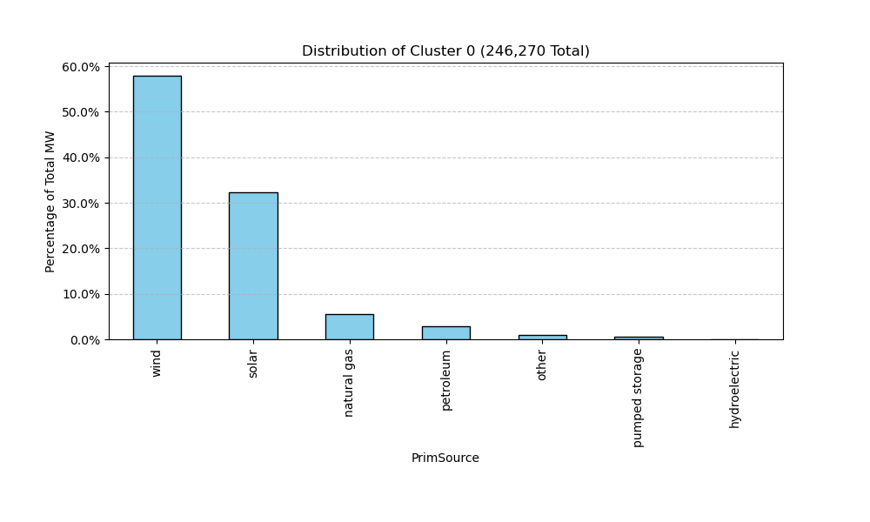
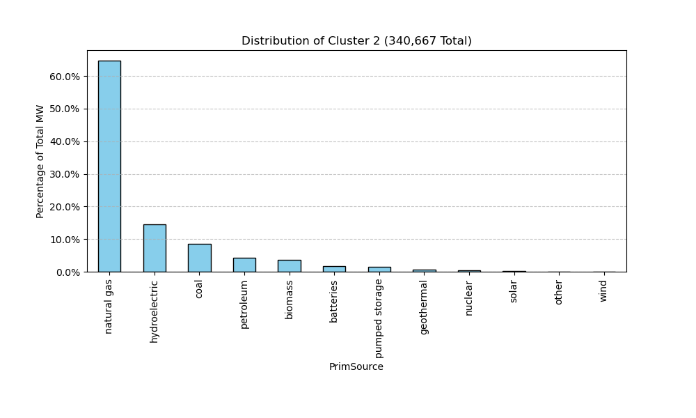
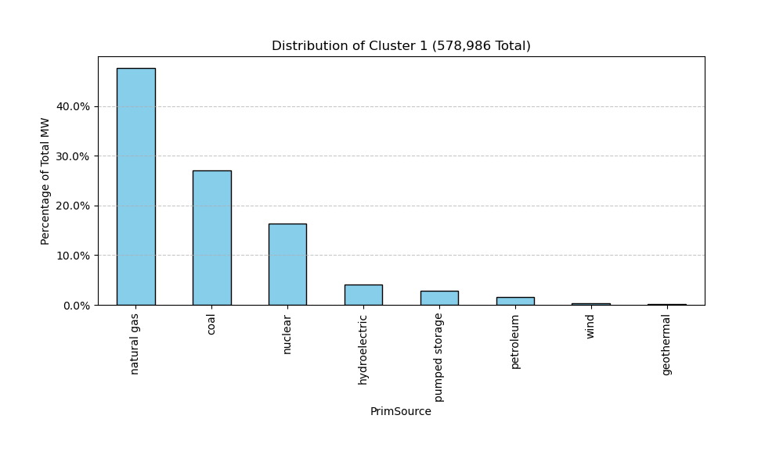
Python Results pt 4

Slide 11
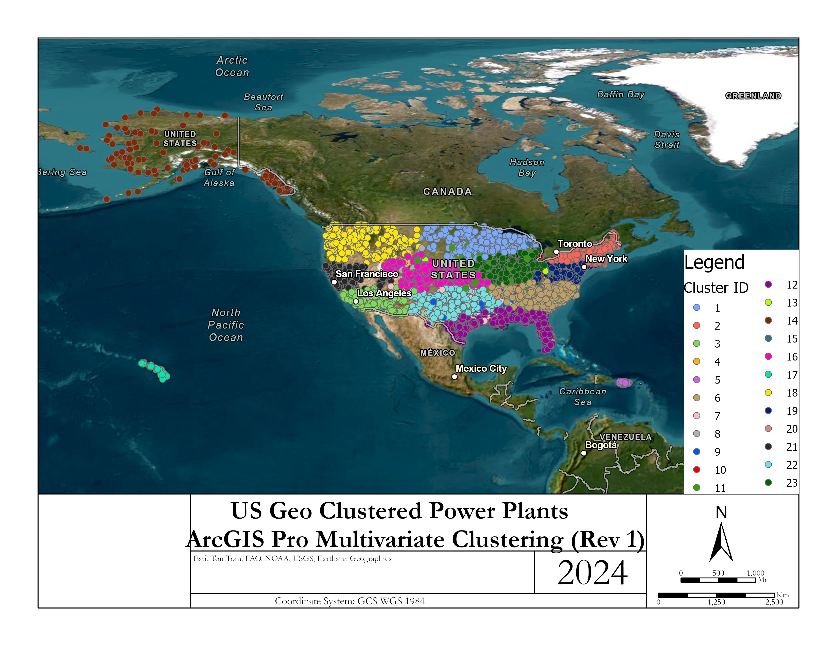
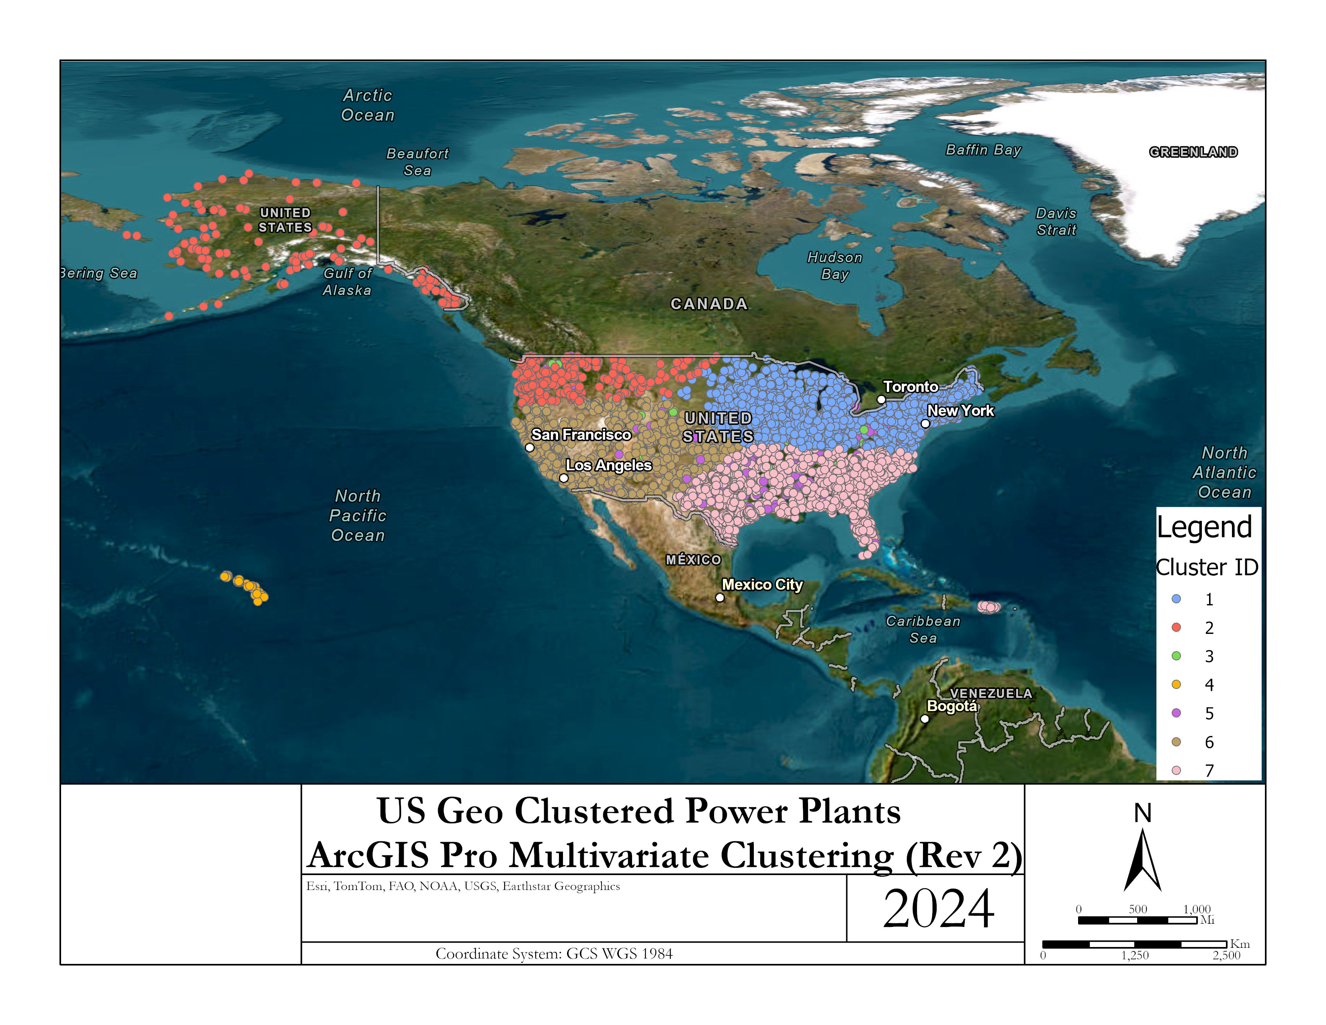
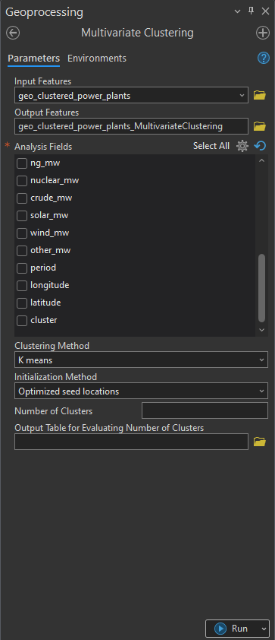
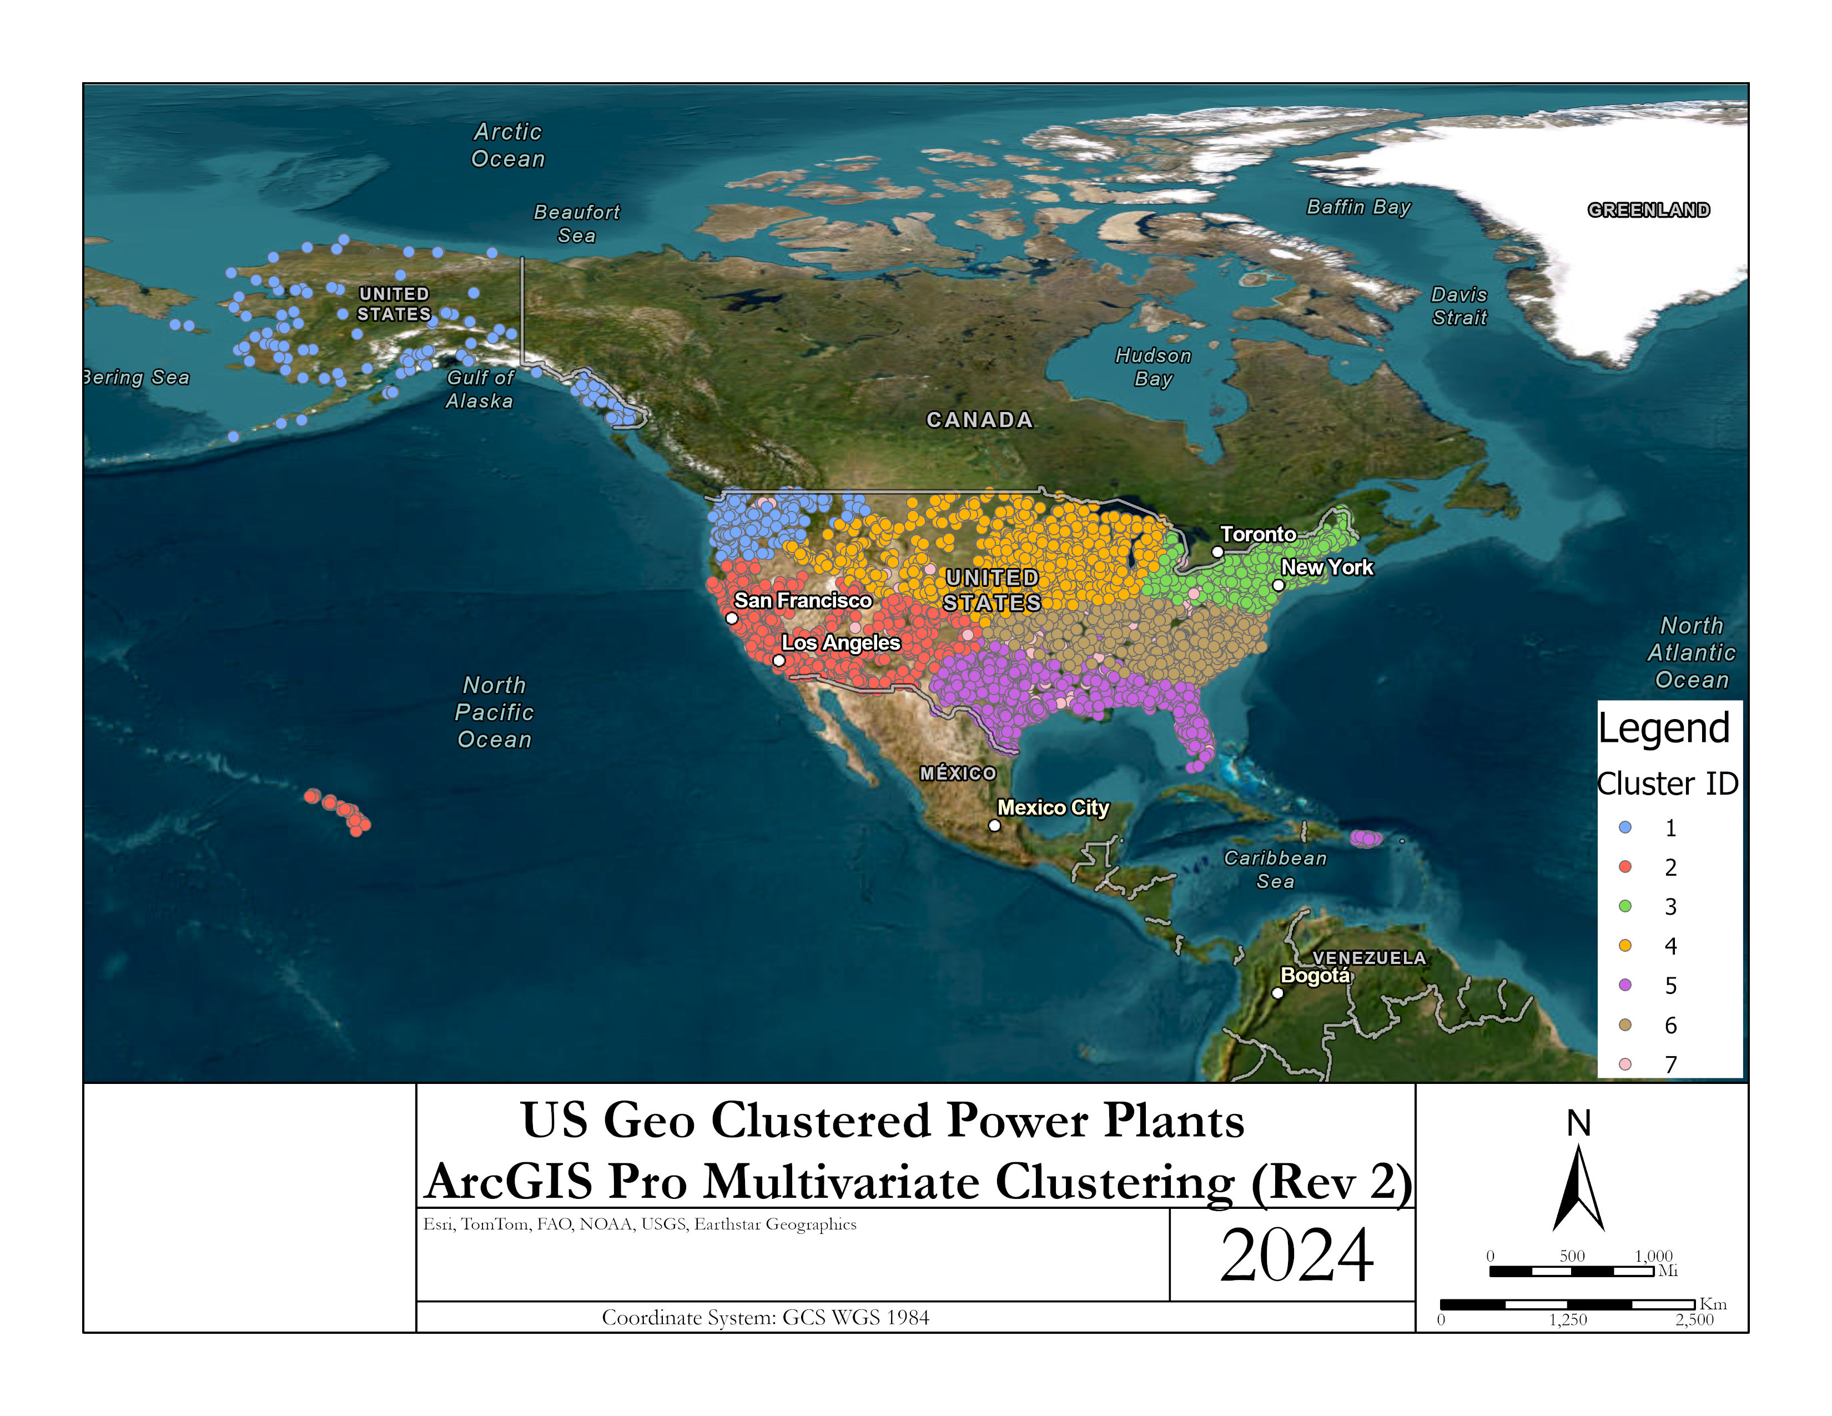
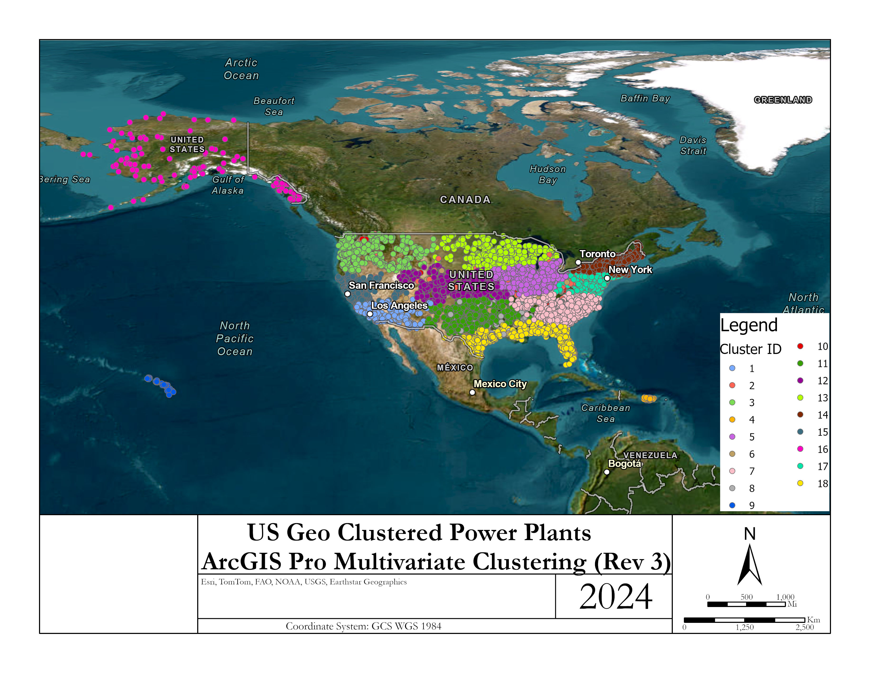
ArcGIS Results

Slide 12
Cluster Analysis Conclusion
We learned that different types of preprocessing can be utilized to perform a variety of further analysis especially depending on the type and variety of data that is collected.
Using power plants gives a wide range of initial attributes.
Once K values are determined even if using the optimum value (i.e. 3) doesn’t translate to accurate clusters. So we played around with different values until we got a proper fit. The best fit from my perspective came with the value of k=7.
ArcGIS Pro has a tool called Multivariate Clustering that we were able to use and compare to our python results and performs other combination of attributes to see how ArcGIS would perform its own clustering.

Slide 13
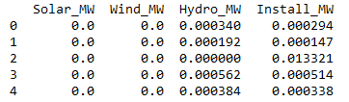
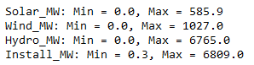
Normalization
Preprocessing Overview
Selected 'Solar_MW', 'Wind_MW', and 'Hydro_MW' to focus on renewable energy sources in line with global sustainability trends.
Included 'Install_MW' to gauge the overall capacity and impact of renewable energy installationsIdentify features and predict them
Normalization: Scale Variance: "Normalized feature values due to wide variance in scales, with capacities ranging from 0 to over 6,000 MW

Slide 14
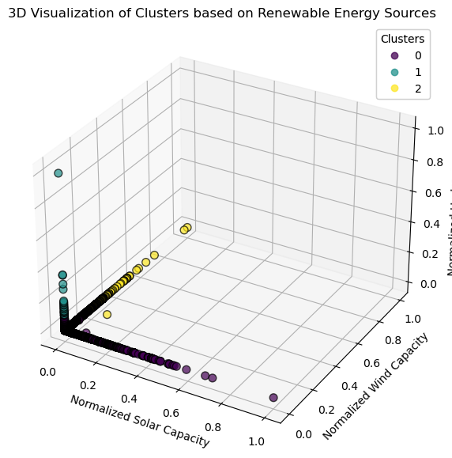
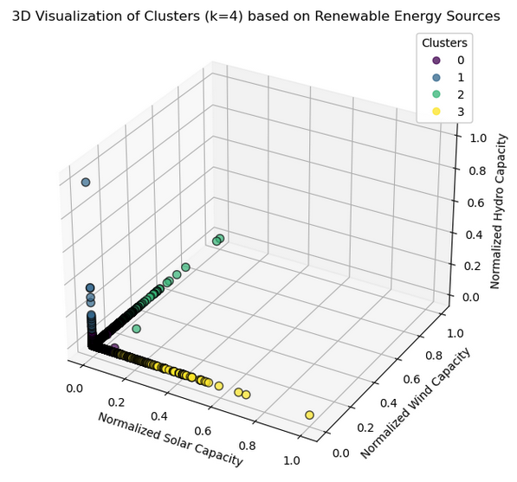
3D Cluster Visualizations

Slide 15
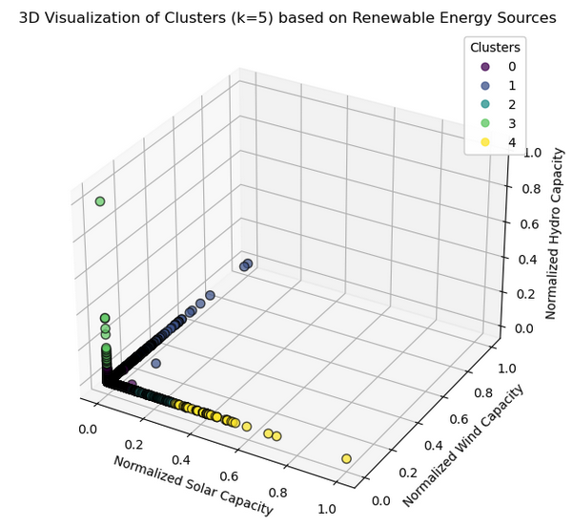
3D Cluster Visualizations

Slide 16
Cluster Analysis
Cluster Analysis for k=3:
We can observe that most data points are clustered close to the origin, which suggests that the majority of power plants have low normalized values for solar, wind, and hydro capacities.
Cluster Analysis for k=4:
This additional cluster might be differentiating plants with a combination of higher hydro and either solar or wind capacities, which was not as distinctly separated with k = 3.
Cluster Analysis for k=5:
With k = 5, there is a new cluster that seems to capture outliers or unique cases of power plants with specific capacity characteristics that were not distinctly grouped in k = 3 or k = 4

Slide 17
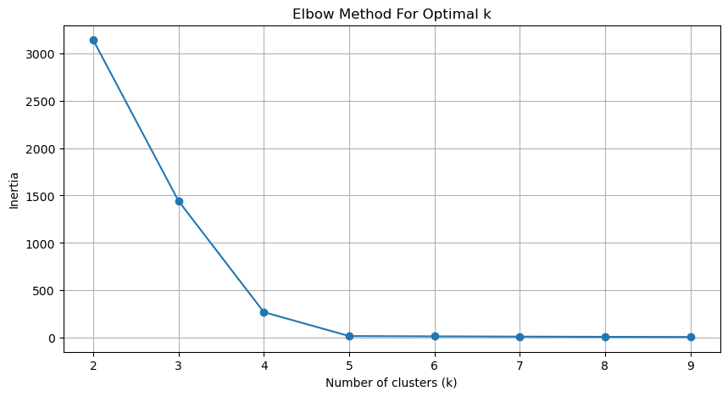
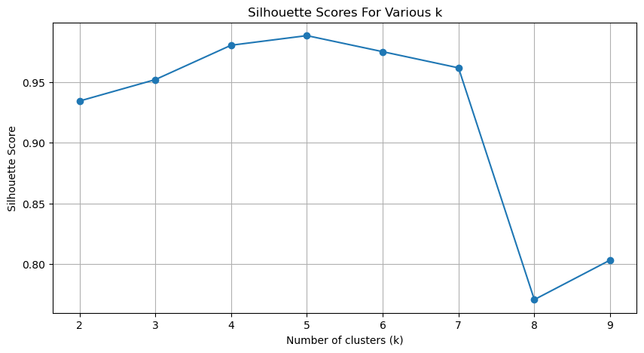
Cluster Validation:
Elbow and Sihouette Plot
Elbow Plot: A graph showing the inertia as a function of k, pointing out the elbow.
Silhouette Plot: A graph of silhouette scores across different values of k, highlighting the score of the chosen k.

Slide 18
Explained
Elbow Plot Slide:
Show the Elbow method plot.
Point out the elbow at k=3 and k=4, explaining that these points are potential candidates for the optimal number of clusters because they represent a balance between inertia and the number of clusters.
Silhouette Score Slide:
Present the Silhouette score plot.
Highlight the peak at k=5, which suggests that each cluster is quite distinct from the others at this number of clusters.
Mention the decline after k=6, and explain that it suggests overfitting—where the model starts to create clusters that do not generalize well.

Slide 19
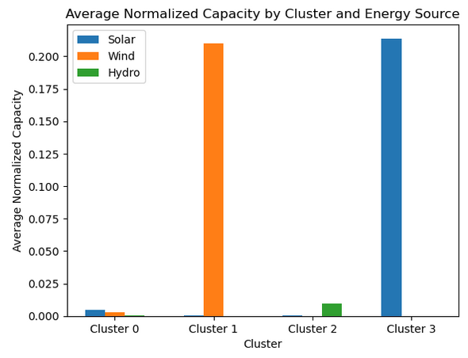
Results
For Cluster 3 (3 Clusters Total):
Cluster 0: Shows negligible renewable energy capacity across all three sources, possibly representing power plants with a primary focus on non-renewable energy.
Cluster 1: Is characterized by a significant investment in wind energy, dwarfing solar and hydro capacities. This cluster might represent wind farms or regions where wind power is heavily favored due to climatic or geographical conditions.
Cluster 2: Stands out with a high hydro capacity, which may include large hydroelectric power plants or regions abundant in water resources conducive to hydro power.

Slide 20
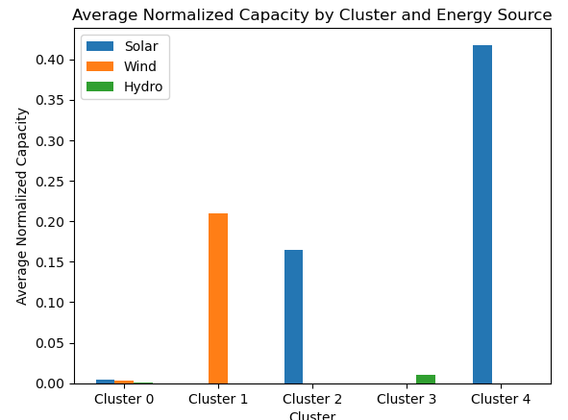
Results
For Cluster 3 (3 Clusters Total)::
Cluster 0: Similar to Cluster 3's Cluster 0, this cluster has very low capacities in renewables, suggesting a focus on other forms of energy.
Cluster 1: Dominates in wind capacity, much like Cluster 3's Cluster 1. It highlights power plants that are potentially leveraging strong wind resources.
Cluster 2: Has a notable balance across all three types of renewable capacities, indicating a diverse renewable energy strategy.
Cluster 3: Shows a preference for solar energy, suggesting locations with high solar irradiance or policy-driven solar energy adoption.
Cluster 4: Is overwhelmingly represented by hydro capacity. This cluster likely includes major hydroelectric power stations, possibly in regions with large rivers or significant water flow.

Slide 21
References
https://montclair.maps.arcgis.com/home/item.html?id=b063316fac7345dba4bae96eaa813b2f (US Power Plants Data source)
https://pro.arcgis.com/en/pro-app/latest/tool-reference/spatial-statistics/multivariate-clustering.htm (ArcGIS - Multivariate Clustering Tool)

